Slide 2
import_qiime2_data.sh
qiime tools import \
--type 'SampleData[PairedEndSequencesWithQuality]' \
--input-path testing \
--input-format 'CasavaOneEightSingleLanePerSampleDirFmt' \
--output-path testing_reads.qza

Slide 3
Demux_summarize.sh
qiime demux summarize \
--i-data reads.qza \
--o-visualization reads.qzv

Slide 4
denoise_qiime2.sh
qiime dada2 denoise-paired \
--i-demultiplexed-seqs reads.qza \
--p-trim-left-f 19 \
--p-trim-left-r 20 \
--p-trunc-len-f 234 \
--p-trunc-len-r 60 \
--o-table testing_dada2-table.qza \
--o-representative-sequences testing_dada2-rep-seqs.qza \
--o-denoising-stats testing_dada2-stats.qza \
--p-n-threads 8

Slide 5
visualize_rep_seqs.sh = summary of denoising
qiime metadata tabulate \
--m-input-file dada2-stats.qza \
--o-visualization dada2-stats.qzv && \
qiime feature-table tabulate-seqs \
--i-data dada2-rep-seqs.qza \
--o-visualization dada2-rep-seqs.qzv

Slide 6
Average_denoised_data.sh – may not be needed
qiime feature-table group \
--i-table dada2-table.qza \
--p-axis sample \
--m-metadata-file metadata.tsv \
--m-metadata-column Site_layer \
--p-mode mean-ceiling \
--o-grouped-table grouped-table.qza

Slide 7
import_classifier.sh
qiime feature-classifier classify-sklearn \
--i-classifier silva-138-99-515-806-nb-classifier.qza \
--i-reads dada2-rep-seqs.qza \
--o-classification taxonomy_silva.qza \
--p-n-jobs 8

Slide 8
taxonomy_tabulate.sh
qiime metadata tabulate \
--m-input-file taxonomy_silva.qza \
--o-visualization taxonomy_silva.qzv

Slide 9
taxonomy_plot.sh – for checking
qiime taxa barplot \
--i-table dada2-table.qza \
--i-taxonomy taxonomy_silva.qza \
--m-metadata-file metadata.tsv \
--o-visualization bar_plots_check_silva.qzv

Slide 10
Remove_mitochondria
qiime taxa filter-table \
--i-table dada2-table.qza \
--i-taxonomy taxonomy_silva.qza \
--p-include d__Bacteria \
--p-exclude d__mitochondria,chloroplast \
--o-filtered-table table_filtered_decontamed.qza

Slide 11
filtered_table.sh
qiime feature-table summarize \
--i-table table_filtered_decontamed.qza \
--o-visualization table_filtered_decontamed.qzv \
--m-sample-metadata-file metadata.tsv

Slide 12
Filtering to 10,000 depth initially as there are 12 samples that have feature counts under 10,000 and there is a maximum feature count of 73,750 (st4-3A)
Now going to filter to 10953
Have full filter script: filtering_analysis.sh where you can change the filtering value

Slide 13
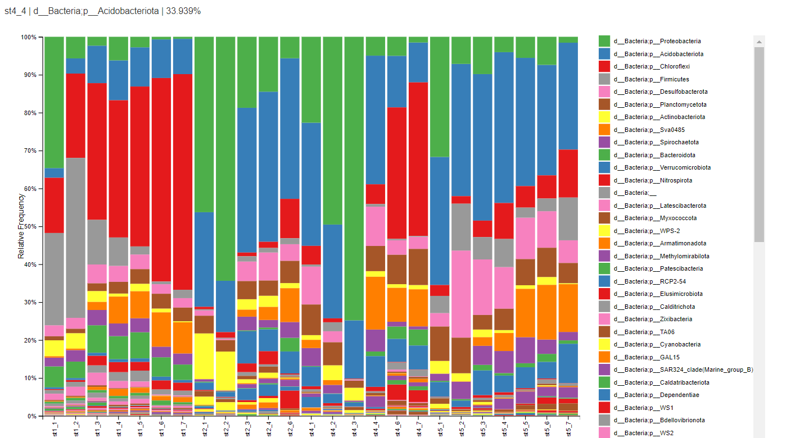

Slide 14
collapsed_table_frequency.sh
qiime tools export \ --input-path collapsed_table_frequency_L2.qza \ --output-path collapsed_table_frequency/L2 # Converting the BIOM file to TSV format biom convert \ -i collapsed_table_frequency/L2/feature-table.biom \ -o collapsed_table_frequency/L2/collapsed_table_frequency_L2.tsv \ --to-tsv

Slide 15
Building phylogenetic tree: build_phylo_tree.sh
qiime phylogeny align-to-tree-mafft-fasttree \
--i-sequences rep_seqs_final.qza \
--o-alignment aligned-rep-seqs.qza \
--o-masked-alignment masked-aligned-rep-seqs.qza \
--o-tree unrooted_tree.qza \
--o-rooted-tree rooted_tree.qza \
--p-n-threads 8

Slide 16
Order of filtering
Sbatch filtering_analysis.sh
Aggregate_pseudoreplicates
Sbatch collapse_levels.sh
Sbatch build_phylo_tree.sh
Calc_ab
Sbatch plot_rarefaction.sh

Slide 17
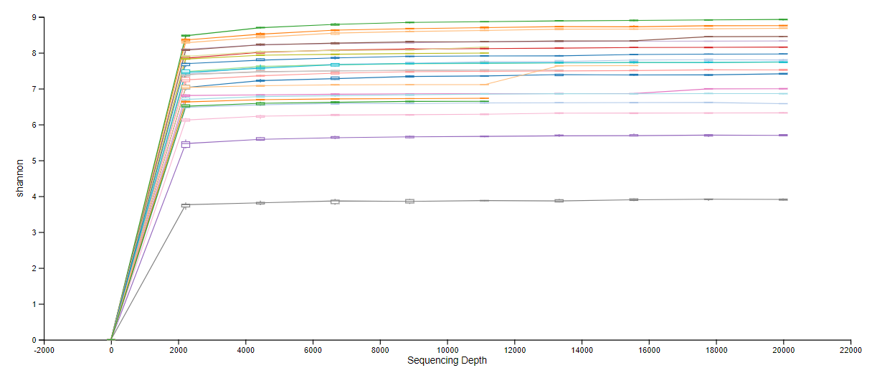
Rarefaction curves not plateauing at low enough depths. Shannon index is fine
10,000 min, 20,000 max:

Slide 18
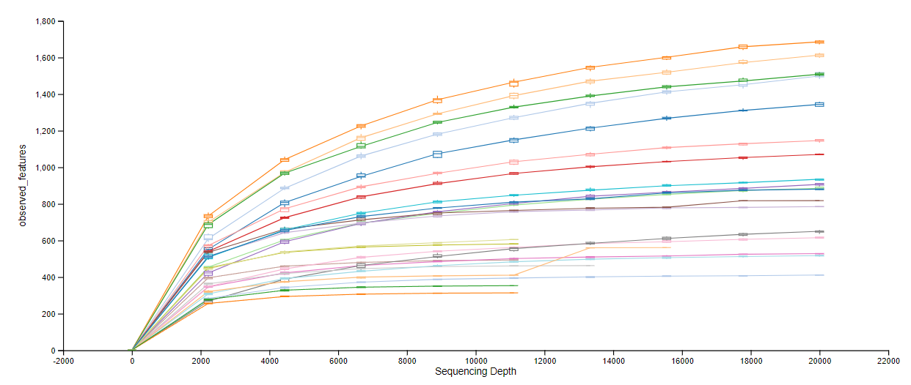
Observed features (beta) less good, 10,000 to 20,000

Slide 19
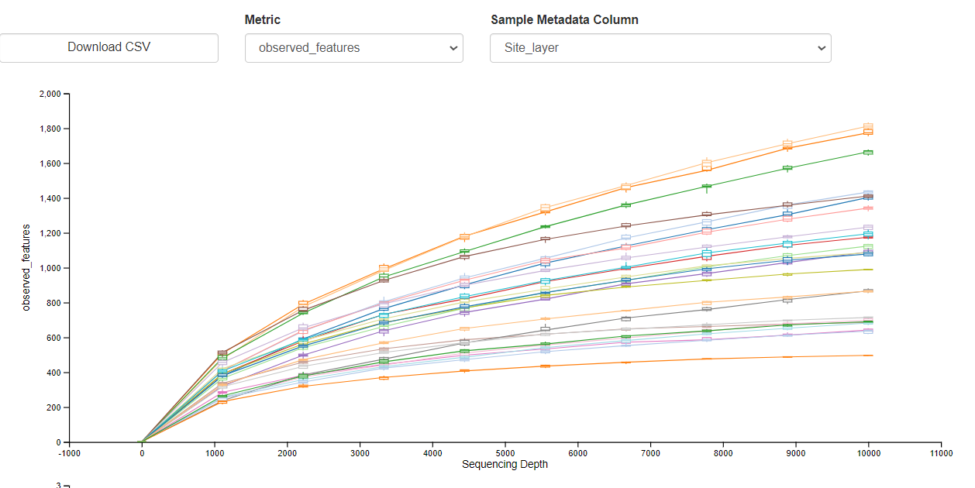
10,000 observed features

Slide 20
Sbatch filter_and_analyse produces core metrics
alpha_group_significance.sh – alpha diversity stuff
Collapse_levels.sh – collapses based on each taxonomic level.

Slide 21
# Alpha-group-significance for observed features
qiime diversity alpha-group-significance \
--i-alpha-diversity core_metrics_results_5225/observed_features_vector.qza \
--m-metadata-file metadata_grouped.tsv \
--o-visualization core_metrics_results_5225/observed_features_alpha-group-significance.qzv
# Alpha-group-significance for Shannon diversity
qiime diversity alpha-group-significance \
--i-alpha-diversity core_metrics_results_5225/shannon_vector.qza \
--m-metadata-file metadata_grouped.tsv \
--o-visualization core_metrics_results_5225/shannon_alpha-group-significance.qzv
# Alpha-correlation for observed features correlation
qiime diversity alpha-correlation \
--i-alpha-diversity core_metrics_results_5225/observed_features_vector.qza \
--m-metadata-file metadata_grouped.tsv \
--o-visualization core_metrics_results_5225/observed_features_alpha-correlation.qzv
# Alpha-correlation for shannon correlation
qiime diversity alpha-correlation \
--i-alpha-diversity core_metrics_results_5225/shannon_vector.qza \
--m-metadata-file metadata_grouped.tsv \
--o-visualization core_metrics_results_5225/shannon_alpha-correlation.qzv

Slide 22
Create_grouped_table.sh – can amend what column of metadate that you are grouping the data by
Collapse_levels_site.sh – can amend to match the names from create_grouped_table.sh

Slide 23
Adonis calc
# Run the QIIME 2 command if qiime is found
if which qiime > /dev/null; then
qiime diversity adonis \
--i-distance-matrix core_metrics_results/bray_curtis_distance_matrix.qza \
--m-metadata-file metadata.tsv \
--p-formula "Phasic_community" \
--p-permutations 9999 \
--o-visualization adonis/adonis_bray_curtis_Sex.qzv \
--p-n-jobs 8

